Slide 1
11/16 발표자료
2018110654 이해님

Slide 2

ndf=48
Test AUC : 0.9305
Epoch | modal | AUC
EPOCH=100 | CLS token 1개 모델 (기존) | 0.9299
 | CLS token 1개 + ndf, ngf=64 | 0.9529
 | CLS token 1개 + ndf, ngf=32 | 0.9169
 | CLS token 1개 + ndf, ngf=128 | 0.9382
 | CLS token 1개 + ndf,ngf=48 | 0.9305
Notes:
20458160
2799616
12161720
703488

Slide 3
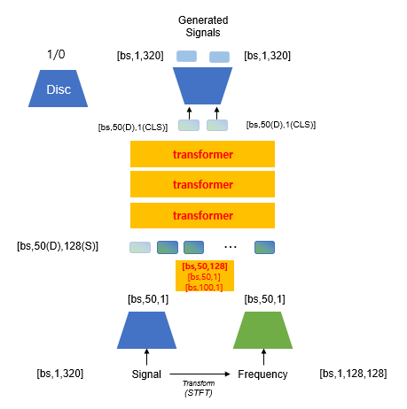
Linear단 feature fusion에 transformer 사용
[bs,50, 128 ]
[bs,50, 128 ]
S+F
Q [bs,50, 128 ]
K, V [bs,50, 128 ]
Linear
Linear
[bs,50,1]
Signal
Freq
[bs,50,1]

Slide 4
Linear단 feature fusion에 transformer 사용
Test AUC : 0.9369
Epoch | modal | AUC
EPOCH=100 | CLS token 1개 모델 | 0.9299
 | CLS token 1개 + ndf, ngf=64 | 0.9529
 | CLS token 1개 + ndf, ngf=64 + Linear단 transformer feature fusion | 0.9369
-0.016
AUC 감소

Slide 5
signal->tf->signal
Multimodal과 head, token수,batch size 등이 다름
=> haed와 token수를 multimodal과 일치하게 변경
Epoch |  |  | modal | AUC
EPOCH =100 | Unimodal | 기존 | Signal -> TF -> Signal (haed=8, token=50, batch=64) | 0.9361
 |  |  | Freq -> TF -> Signal (haed=8, token=50, batch=32) | 0.9269
 |  | Multimodal과 같이 수정 | Signal -> TF -> Signal (haed=5, token=128, batch=64) | 0.9455
 |  |  | Signal -> TF -> Signal (haed=5, token=128, batch=32) | 0.9449
+0.0094
+0.0088
AUC 증가

Slide 6
freq->tf->signal
Multimodal의 head, token수와 다름 => haed와 token수를 multimodal과 일치하게 변경
Test AUC : 0.9204
Epoch |  |  | modal | AUC
EPOCH =100 | Unimodal | 기존 | Signal -> TF -> Signal (haed=8, token=50, batch=64) | 0.9361
 |  |  | Freq -> TF -> signal (haed=8, token=50, batch=32) | 0.9269
 |  | Multimodal과 같이 수정 | Signal -> TF -> Signal (haed=5, token=128, batch=32) | 0.9455
 |  |  | Freq -> TF -> Signal (haed=5, token=128, batch=32) | 0.9204
-0.0065
AUC 감소

Slide 7
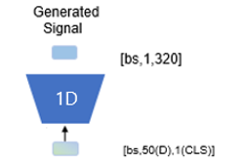
Pretrained encoder
1D
from singal->tf->signal
(beatgan +tf)
from freq->tf->signal
1D
2D

Slide 8

Pretrained encoder
Test AUC : 0.9259
Epoch |  | modal | AUC
EPOCH =100 | Head=8 Token=50 | Signal -> TF -> Signal (haed=8, token=50) | 0.9361
 |  | Freq -> TF -> (haed=8, token=50) | 0.9269
 | pretrain | CLS token 1개 모델 + Pretrained encoder (signal encoder = beatgan + tf, Freq encoder = freq -> tf -> signal) | 0.9222
 | Head=5 Token=128 | Signal -> TF -> Signal (haed=5, token=128) | 0.9455
 |  | Freq -> TF -> Signal (haed=5, token=128) | 0.9204
 | pretrain | CLS token 1개 모델 + Pretrained encoder (signal encoder = beatgan + tf, Freq encoder = freq -> tf -> signal) | 0.9259
-0.0139
-0.0047
+0.0055
-0.0196

Slide 9
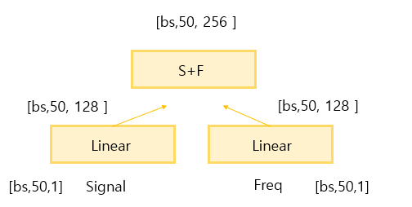
Token 256모델 + Pretrained Linear layer, encoder
1D
from singal->tf->signal
(beatgan +tf)
from freq->tf->signal
Linear단 feature fusion
from singal->tf->signal
(beatgan +tf)
1D
2D
from freq->tf->signal

Slide 10
Token 256모델 + Pretrained Linear layer, encoder
학습중

Slide 11
Token=128 모델, Pretrained Linear layer, encoder
1D
from freq->tf->signal
from singal->tf->signal
(beatgan +tf)
1D
2D
from freq->tf->signal

Slide 12
Token=128 모델, Pretrained Linear layer, encoder
학습중

Slide 13
Epoch |  |  | modal | AUC
EPOCH =100 | Unimodal | 기존 | Signal -> TF -> Signal (haed=8, token=50) | 0.9361
 |  |  | Freq -> TF -> (haed=8, token=50) | 0.9269
 |  | Multimodal과 같이 수정 | Signal -> TF -> Signal (haed=5, token=128) | 0.9455
 |  |  | Freq -> TF -> Signal (haed=5, token=128) | 0.9204
 | Multimodal | 기준모델 | CLS token 1개 모델 ([bs,50,1]+[bs,50,1]->[bs,100,1]-> [bs,50,1] -> [bs,50,128]) | 0.9299
 |  | Ndf, Ngf 변경 | CLS token 1개 모델+ ndf, ngf=64 | 0.9529
 |  |  | CLS token 1개 모델+ ndf, ngf=32 | 0.9169
 |  |  | CLS token 1개 모델+ ndf, ngf=48 | 0.9305
 |  | Linear 단 Feature Fusion 변경 | CLS token 1개 모델 + [bs,50,1],[bs,50,1]->[bs,50,128], [bs,50,128]-> [bs,50,256](토큰 256) | 0.9323
 |  |  | CLS token 1개 모델 + [bs,50,1],[bs,50,1]->[bs,50,128], [bs,50,128]-> [bs,50,256](토큰 256) +ndf, ngf = 64 | 0.9399
 |  | Pretrained Encoder 사용 | CLS token 1개 모델 + Pretrained encoder (head=8, token=50) (signal encoder = beatgan + tf, Freq encoder = freq -> tf -> signal) | 0.9222
 |  |  | Pretrained encoder (signal encoder 2개 : beatgan + tf) | 0.9292
 |  |  | CLS token 1개 모델 + Pretrained encoder (head=5, token=128) (signal encoder = beatgan + tf,Freq encoder = freq -> tf -> signal) | 0.9259

